Slide 1
FIFA - World Cup Analysis
Using python

Slide 2
Introduction
The FIFA World Cup is an international association football competition contested by national teams every four years. The tournament is organized by the Fédération Internationale de Football Association (FIFA) and has been held since 1930, with teams from around the world participating.
FIFA World Cup analysis can be conducted using various tools, including statistical software (e.g., Python with Pandas, NumPy, and Plotly), and data visualization tools, for advanced insights

Slide 3
Datasets :
In this project there are 3 Dataset Used,
WorldCupMatches.CSV
WorldCupPlayers.CSV
Worldcups.CSV

Slide 4
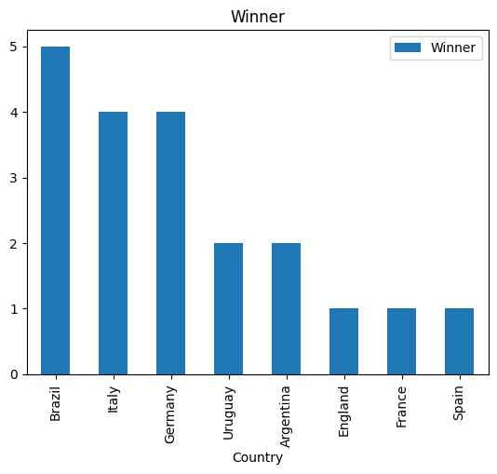
Most Number of World Cup Winning Team :
Brazil has won more number of world cups,it has won world cup title 5 times

Slide 5
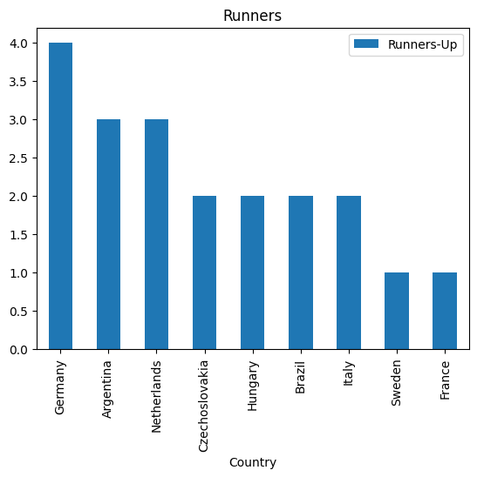
Most Number of Runnner Team:
Germany has won more number of runner title, it became runner 4 times

Slide 6
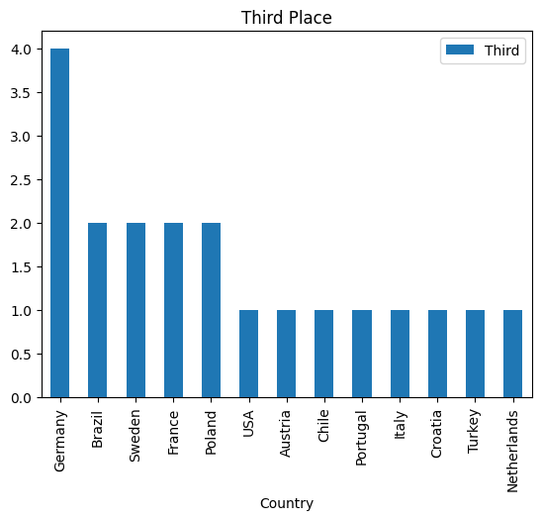
Most Number of third place Team :
Germany has became Third place 4 times

Slide 7
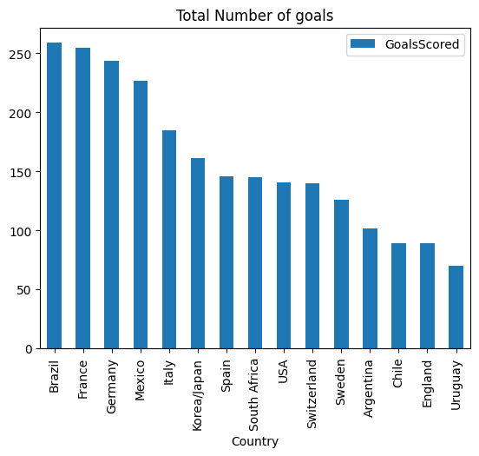
Total number of goals by each team :
Brazil is the top scored Team. and it has scored 259 goals in Overall

Slide 8
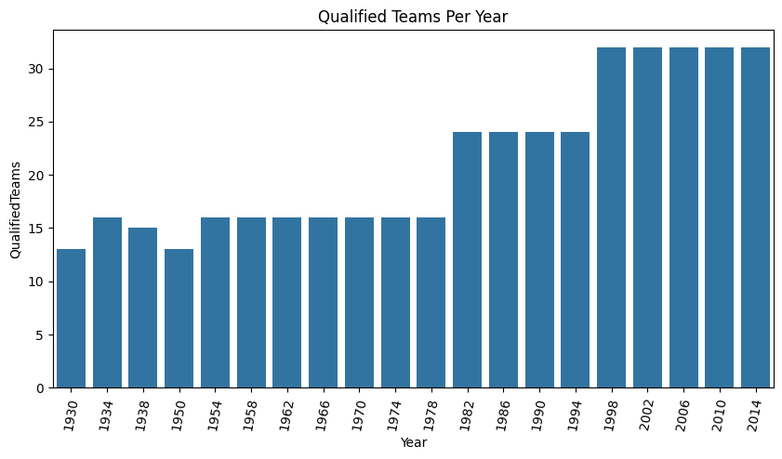
Number of Teams Qualified per year :
In 2002, 2006, 2010, 2014 more no of teams are qualified.
Count : 32

Slide 9
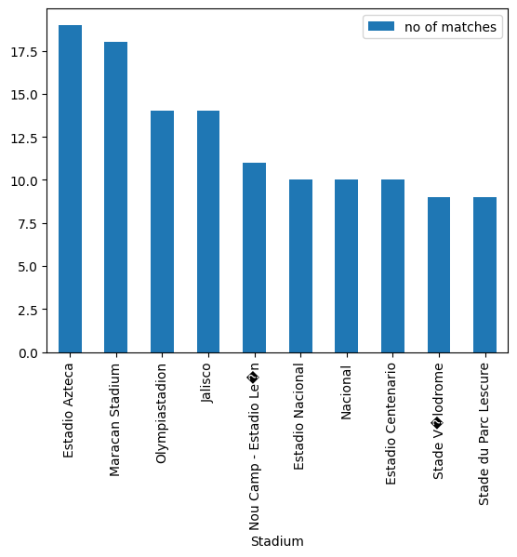
Top 10 Stadiums with most no of matches played :
Most of the macthes played in Estadio Azteca Stadium

Slide 10
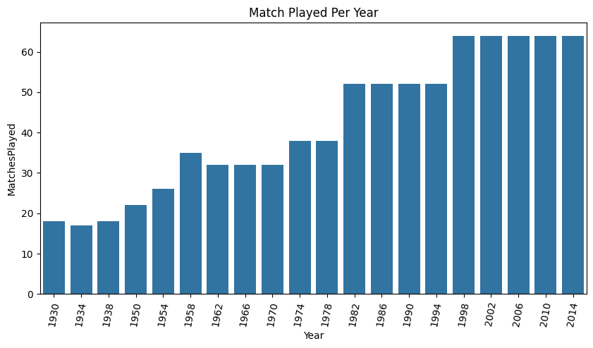
No of Matches played per year :
In 2002, 2006, 2010, 2014 more no of matches played.
Count : 64

Slide 11
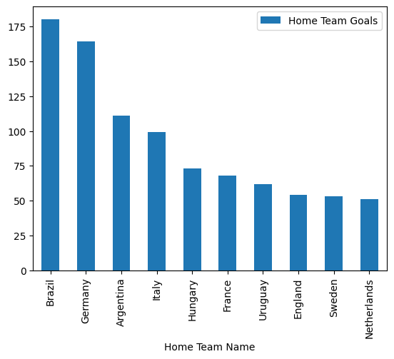
Top 10 Teams with most no of Goals in their Home :
Brazil has scored most no of Goals in their Home,
it scored 180 goals

Slide 12
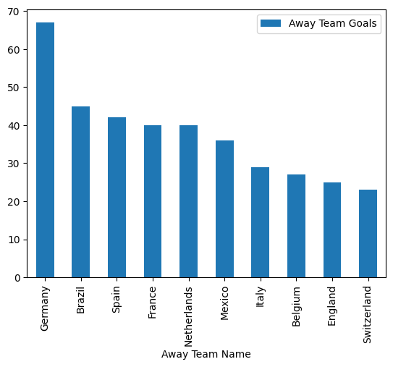
Top 10 Teams with most no of Goals as a Away Team :
Germany has scored most no of Goals as a Away Team,
it scored 67 goals

Slide 13
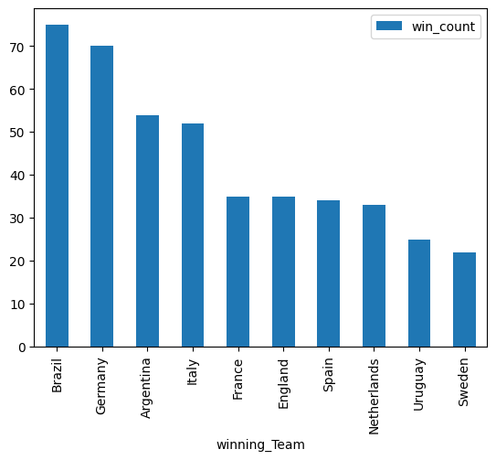
Top 10 Teams with maximum win count :
Brazil has won most no of matches in FIFA worldcup series,
it has won 75 matches

Slide 14
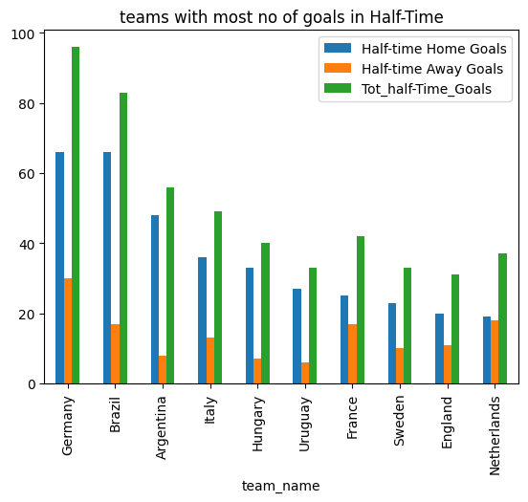
Top 10 teams with most no of goals in Half-Time :
Germany and Brazil has scored more goals in Half-Time in their home ground
Germany has scored more goals in Half-Time as a Away Team
Germany has scored more goals in Half-Time, it has scored 96 goals

Slide 15
THANK YOU !

